Slide 1
BLOOD DONATION
Track1_Applied_CC_for_Software_Development
Presented by:
1.NADAVALA VISHNU PRIYA _ 21RU5A0407
2. KUMMARI PRAVALLIKA _ 20RU1A0429
3.POLDAS PADMAJA _ 20RU1A0448
4.KUPPAGANTI MOUNIKA _ 20RU1A0529
Guided By:
Hrishikesh Mahure
Edunet Foundation

Slide 2
OUTLINE
Abstract
Problem Statement
Proposed Solution
System Architecture
System Development Approach
Algorithm & Deployment
Conclusion
Reference
Future scope

Slide 3
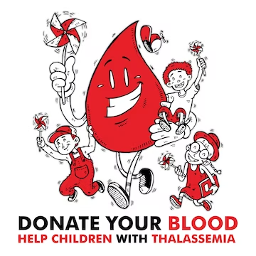
Abstract
Thalassemia is a heterogeneous group of blood disorders affecting the hemoglobin genes and resulting in ineffective erythropoiesis. Blood donation is a vital part of worldwide healthcare. It relates to blood transfusion as a life-sustaining and life-saving procedure as well as a form of therapeutic phlebotomy as a primary medical intervention. Over one hundred million units of blood are donated each year throughout the world. This article will concisely discuss a short history of blood donation origin and purpose, blood testing, donor eligibility and selection, adverse effects of donation, blood donation as a primary medical intervention, and a brief discussion of pathogen reduction and inactivation for donated blood.

Slide 4
Problem Statement
It is not that people do not want to donate blood, but because they have no idea where they can donate
People who need blood are increasing day by day. People who have diseases like anemia or people who have gotten into accidents and run out of blood need constant supply of blood to sustain their life and there is not enough blood available for them. It is not that people do not want to donate blood, but because they have no idea where they can donate. It is important for the people who are excited to donate, but yet are very busy, to be sure where and when they can donate [4],and therefore We are designing a system which contains all the information regarding blood donation camps ongoing in a particular area so that people who want to donate blood will get information regarding these camps.

Slide 5
Proposed Solution
The basic solution is to create a centralized system to keep a track on the upcoming as well as past Blood Donation Events. The recommendation solution is as follows:
Be able to predict the feasible date in order to get the maximum response.
● An Emergency button is introduced in order to guarantee the safety of Donors.
● The call will be dialed automatically to the ambulance once the donor meets an accident.
● A centralized system is designed in order to keep a record of the past and upcoming events.
● Donors will save the donor card digitally.
● The Programmer Officer will

Slide 6
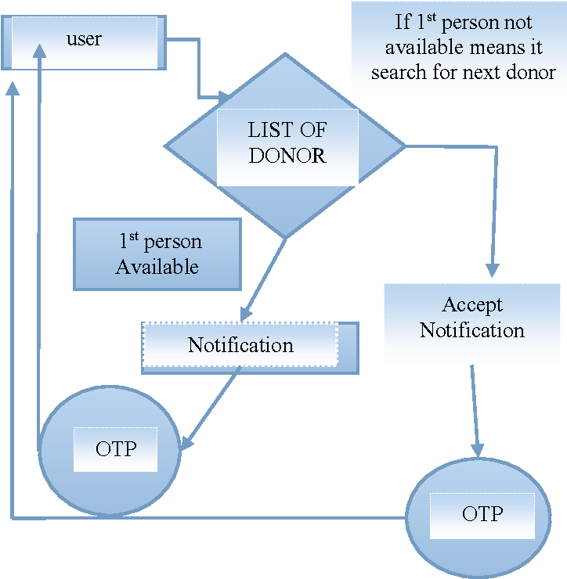
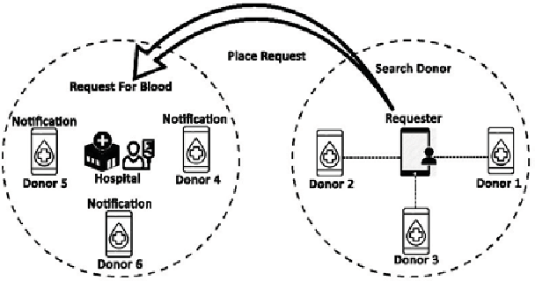
System Architecture

Slide 7
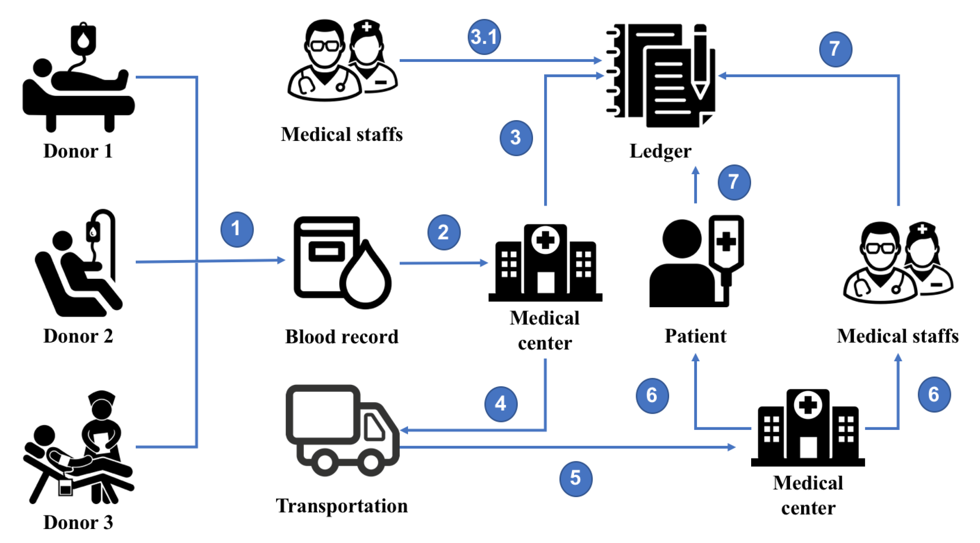
System Deployment Approach

Slide 8
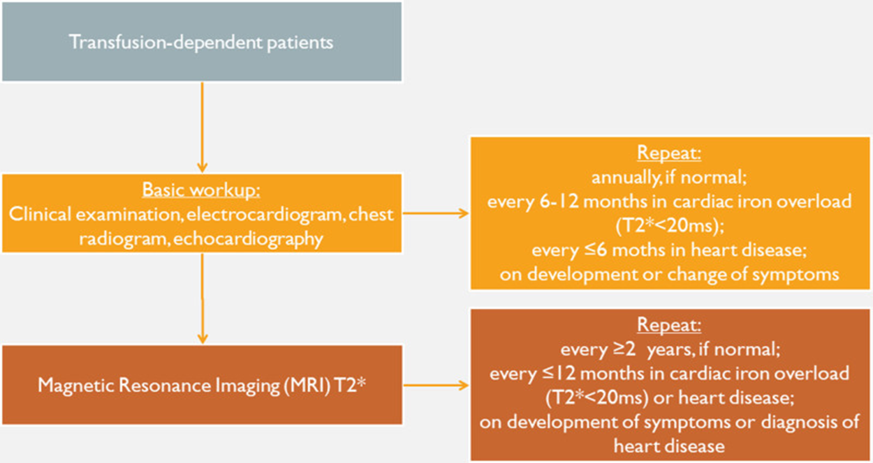
Algorithm & Deployment

Slide 9
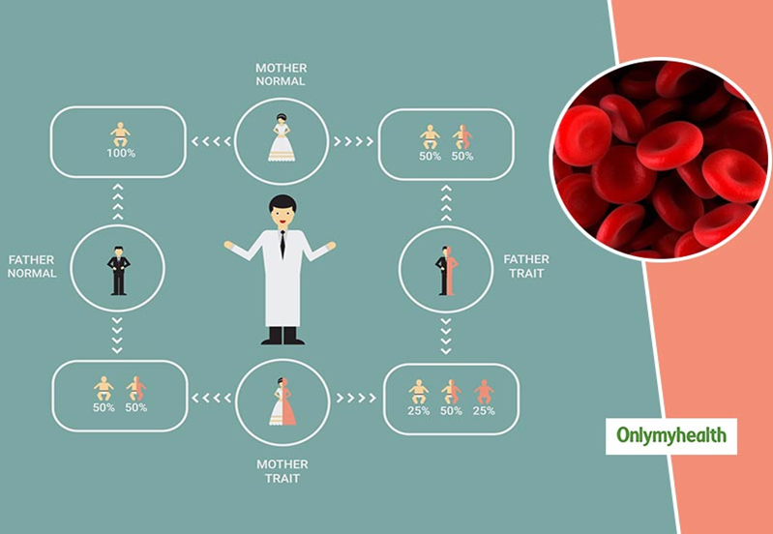
Conclusion
Thalassemia is a genetic blood disorder that affects the production of haemoglobin, which can cause anaemia, fatigue, and other health problems. The condition can be mild or severe, and treatment options depend on the type and severity of the thalassemia. While there is no cure for thalassemia, ongoing management and treatment can help to manage the symptoms and improve the quality of life for people living with the condition.

Slide 10
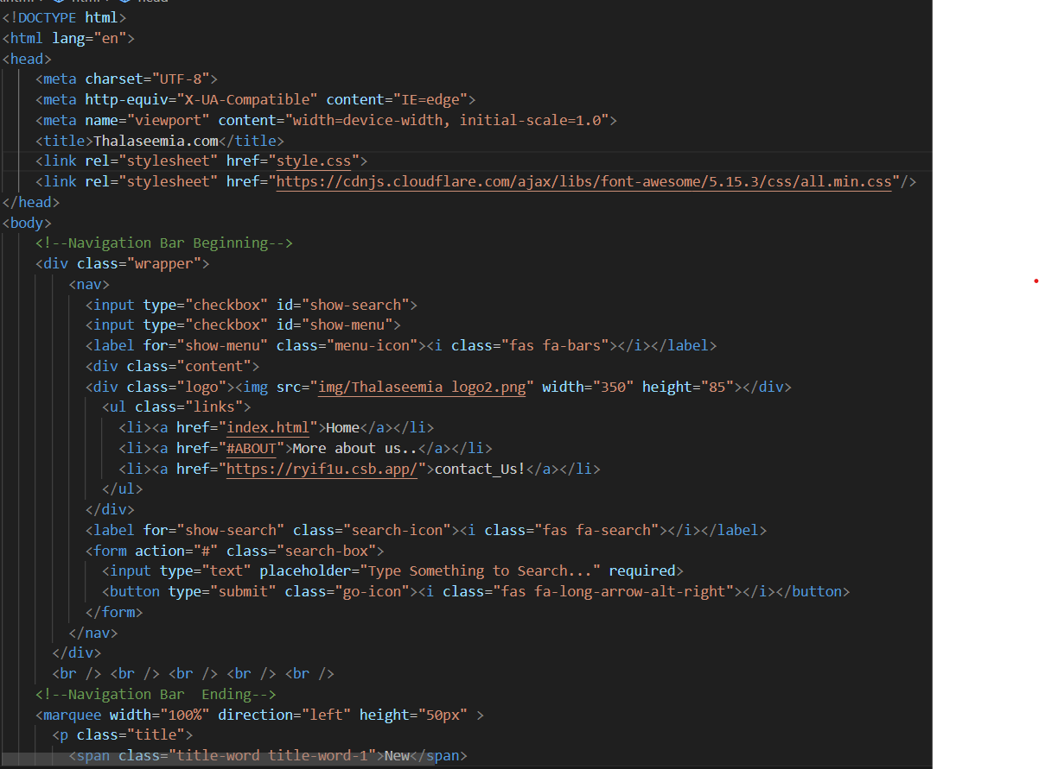
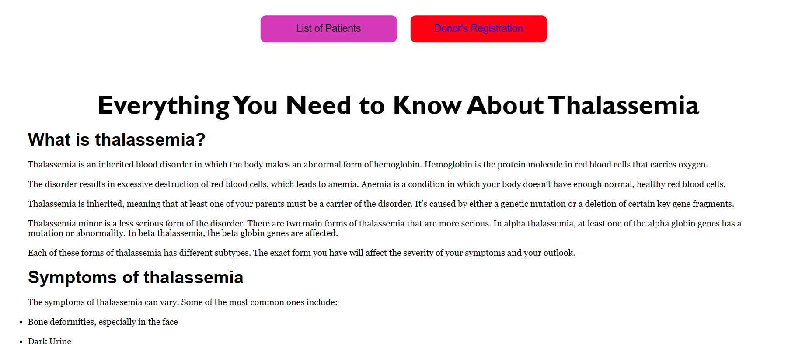
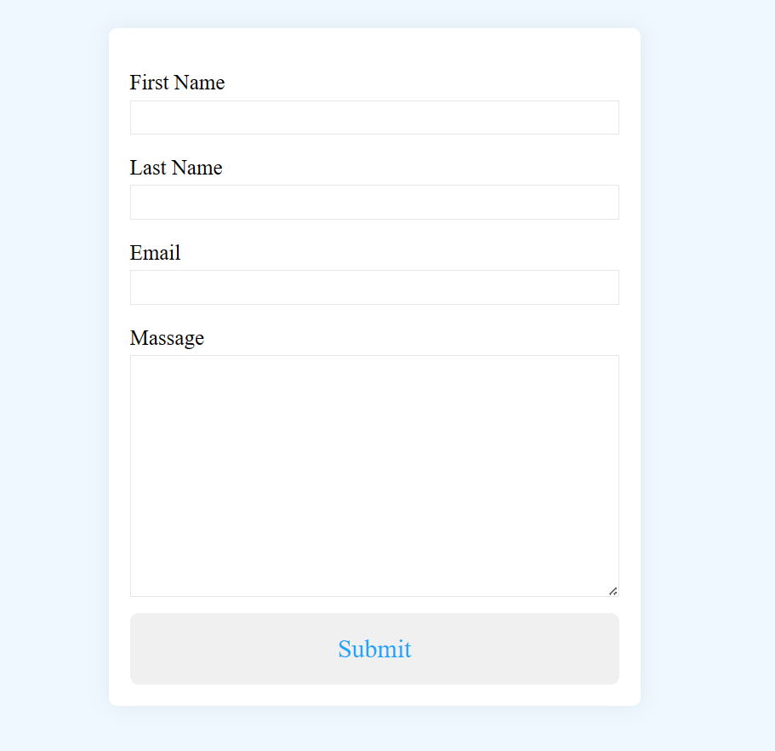

Slide 11
Reference
In many hospitals and blood transfusion centers worldwide, it is a common practice to accept blood from thalassemic trait donors with Hb levels more than 13.5 g/dl (Carmona et al, 1988). In this study, 6 out of the 13 donors with thalassemia had low Hb levels, rendering them unsuitable for donation.
You must not donate blood if you have had babesiosis. You will be permanently deferred. If you have G6PD (Glucose-6-Phosphate Dehydrogenase Deficiency) or Thalassemia (minor), you can donate blood if you meet the haemoglobin requirement. Inform our medical staff if you have G6PD or Thalassemia.
Blood should be transfused at 5 mL/kg per hour, and the post-transfusion hemoglobin should not exceed 14 g/dL. In patients with severe anemia (hemoglobin less than 5 g/dL) or cardiac compromise, the rate of transfusion should be reduced to 2 mL/kg per hour to avoid fluid overload.

Slide 12
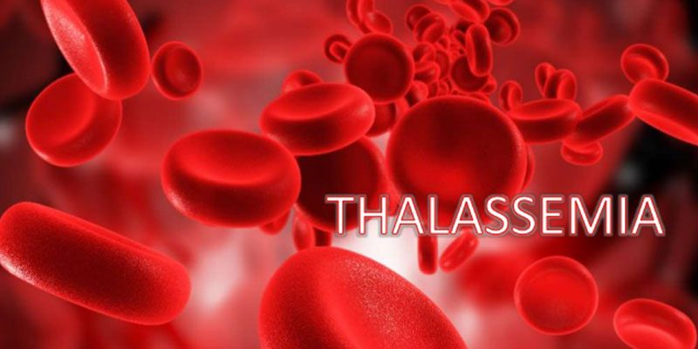
Future Scope
This type of treatment is showing promising results in treating BT. Scientists take some of your own blood stem cells and insert a Hb gene into them in the laboratory.
In the last few years there has been a dramatic advancement in the field of chelation therapy, genetic factors ameliorating the clinical phenotype, hemoglobin switching, gene therapy with lentiviral vectors and development of embryonic-like stem cells obtained by transfection and reprogramming differentiated somatic ..
Unlike supportive blood transfusions, allogeneic bone marrow transplantation (BMT) or HSC transplantation offers the hope of a definitive cure for patients with transfusion-dependent β-thalassemia.

Slide 13


